Slide 1
Where do bart riders go?
Kenneth ceglia
Colorado State University Global
Course Code: mis581
Instructor: Dr. Ford
Due Date: 9 May 2021

Slide 2
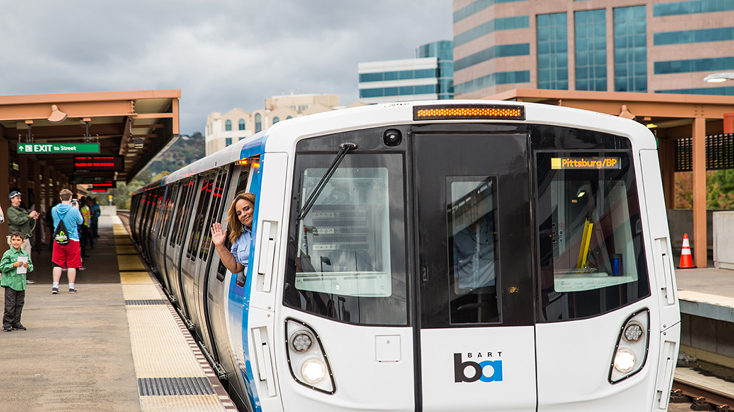
overview
BART
Bay Area Rapid Transit
1971
50 Stations and Growing
~500,000 Riders per Day
All Electric 95% Renewable
Figure 1. From Railway Age by Marybeth Lucza, 2020 (https://www.railwayage.com/passenger/rapid-transit/bart-pausing-new-car-deliveries/).
Notes:
BART is an advanced public transportation network that links communities in the San Francisco Peninsula with cities in the East and South Bay as far south as Millbrae and as north as Richmond. BART has been in operation for over 45 years carrying citizens to and from work, universities and colleges, special and sporting events. BART runs on all electric cars with the majority of power (95%) coming from renewable energy sources making BART one of the most environmentally successful public transportation systems in the world (Sustainability, n.d.).
Like any service, BART faces competition and demands for improved services. Over the last few years (prior to Covid-19) ridership has declined due to crowded trains, security and sanitation concerns. Riders expect more services, better schedules and improvements to stay on board. One of the ways to improve BART is to better understand who, when and how it is being used.
The goal of this study is to analyze ridership route patterns to provide analytics that can be used to improve the lives and services of BART riders and local businesses (Wang et al., 2019). By understanding and predicting the ridership profiles, BART and local businesses can offer improved services to attract new riders and retain existing ones (Andrews et al., 2016).

Slide 3
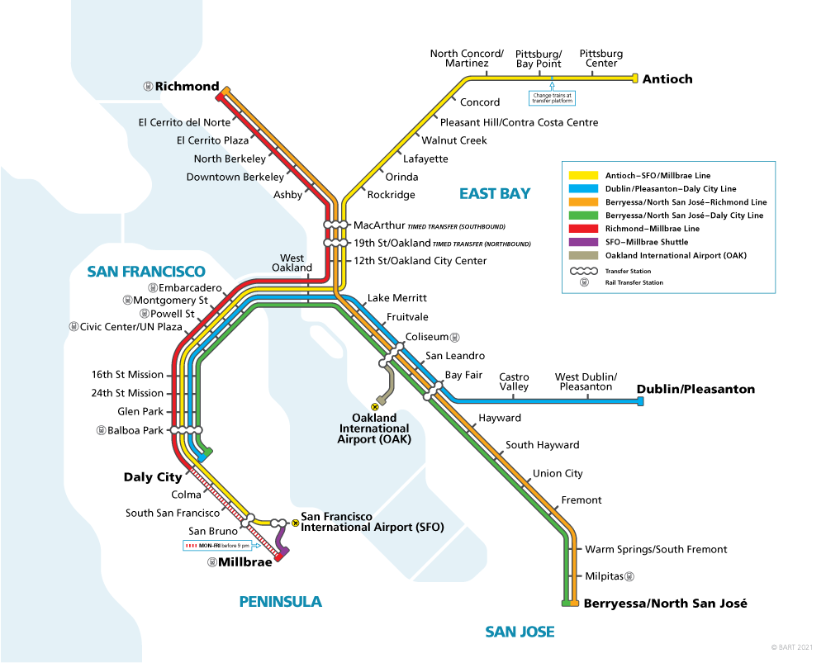
objective
Patterns
Do Riders follow the same paths?
Predict Station Queues
Predict where riders going to and coming from
Why?
Figure 2. From BART, Bay Area Rapid Transit, 2021 (https://www.bart.gov/schedules). In the public domain.
Notes:
The focus or objectives of this research is determining if route patterns are discoverable, repeatable and predictable and if these patterns provide opportunities for rider and local business services. There are several different types of patterns in this study.
On one end is total ridership. How many riders are using the rail system? Knowing if total ridership is changing is particularly important for the BART system itself. For example, knowing if total ridership is increasing or decreasing can direct focus towards improved rider services, such as more trains or better schedules
The next level is how many riders are at each station. How crowded is each station and is this predictable by day or even hour?
The final level is looking at where riders are going and where they are coming from.
Next, we are going to look at why these are important and what we can do with this information

Slide 4
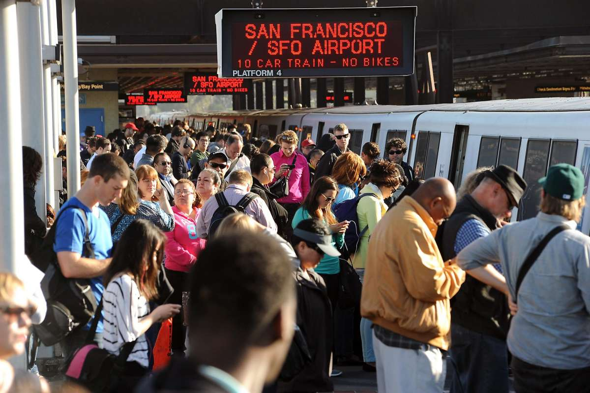
Marketing, Maintenance and Riders
Direct Marketing
Local Businesses
BART
Improve Services
Competition
Riders
Better Services
Encourage more Riders
Happy Riders
Figure 3. From Here's why your BART train is extra-crowded this week
, by Matier and Ross, San Francisco Chronicle, 2017 (https://www.sfchronicle.com/bayarea/article/Here-s-why-your-BART-train-is-extra-crowded-11168456.php).
Notes:
Studying subway or light rail usage is an ongoing effort for most major metropolitan cities. One of the best ways towards continual improvement is understanding the current riders.
While subways and light rails are forms of public transportation usually managed by government authorities, they still face the same competition as any business and must continue to innovate and find new ways to improve services to stay competitive and healthy and reduce congestion (Keler et al., 2020).
One simple way to keep services competitive is timeliness. Late trains, overcrowded stations are often seen as the biggest deterrent from using subways. Riders would rather endure impacted trains than late ones (Kou et al., 2017).
Another problem with overcrowding is reduced sanitation and health concerns. As the number of riders entering or leaving a station grows, so do the health and environmental conditions for that station. Air quality can quickly degrade with increased riders (Xu & Hao, 2017). Riders are likely to avoid subways for fear and concern of viral transmissions such as Covid-19 transmission (Tan & Ma, 2020) and use other forms, such as private car to get.
While BART is a governmental project, it operates like any profit and loss business. BART must continue to look for new ways to increase revenues. Targeted ads are one such way. Knowing how many riders are entering and leaving a given station on given day and hour and, even more important, where those riders are coming from and departing to, provides an opportunity for local business to advertise to a very targeted group of commuters (Ketelaar et al., 2018). Local business could target ads that are highly sensitive to the estimated number of riders who will be visiting or passing by their place of business at any day or hour (Vukasović, 2020). For example, a coffee shop could present advertisements at the origin station, knowing the number of riders heading towards their shop, and continue ads on the commute to further encourage customers to stop by and purchase a cup of coffee.
Finally, and importantly, BART is an extremely environmentally positive transportation service. It is estimated that each commuter, in comparison to a private vehicle, the equivalent of 224 miles per gallon on average and up to 422 miles per gallon during peak times (Sustainability, n.d.). Many countries and cities are transitioning from increasing road-based commutes to rail based to improve quality of life and reduce emissions all at the same time (Ćetković et al., 2020). The more riders are aware of the positive impact they are having by using public transportation services, perhaps the more encouraged riders will feel to continue using such an innovative service and experience the joy and stress-free commutes of public transportation (Ercan et al., 2016).

Slide 5

Ethical considerations
Remove any personal data
Report any personal data
BART is a personal preference
Some bias
Figure 14. From Business Ethics Research Paper: Topics and Writing Recommendations, 2015, Coolessey (https://coolessay.net/blog/post/business-ethics-research-paper-topics).
Notes:
All data used in the study is acquired from BART directly through the Open Data Initiative. There is an assumption here that the data has been carefully scrubbed for any personal details or other privacy details embedded in rider data. Still, an abundance of caution and attention is made to ensure any details that might has gone unnoticed are not exposed in this study. Anything to the contrary will be made known to BART authorities.
There is always a concern how somebody may use this data in a negative way and take advantage of a situation or disparity (Lucan et al., 2017). This is probably always the case with any research. Somebody can use the results for wrong-doing. This study focuses (or attempts to) on the good or positive outcomes possible through better understanding of rider commute routes and station utilization. Ideally, this, if anything at all, will encourage end users to focus on these positive potentials.
Conflict of Interest
This study does represent a small conflict of interest in that the author uses the subway system as the primary means of personal transportation. There is a natural desire to keep the subways improving, so there could be a bias towards seeking those results.

Slide 6

Methodology
Data supplied by BART
Open Data Initiative
Every Rider accounted for since 2011
Entry/Exit data
Per Day, Per Hour
Massive data
3.5 Gigabytes
Filtered to weekdays
Focused on 2019
Figure 4. From BART Open Data Initiative
(Welcome - BART Data Portal).
Notes:
All data for study provided by BART Open data initiative. Established over a decade ago, provides developers, data analyst and anybody interested a rich source of data.
BART data accounts for every rider since 2011 who entered and exited a station, summarized by hour. This is an incredible amount of data, almost four gigabytes of CSV files.
BART has a large number of scheduling apps available, mostly for free due to this generous open data initiative

Slide 7

Discovery
Narrow Down
50 Stations, 8 Lines
50 x 49 = 2450 routes
Where Going To
Where Coming From
Riders
7:00AM
Day
Year
From
To
Figure 5. Total riders departing morning commute, generated by
© Mapbox, © OpenStreetMap
Notes:
To focus the analysis, the BART top level network is observed for the most common routes and commute hours where a departure and arrival station route is selected from the Antioch-SFIA line. The Antioch-SFIA line was selected to limit the initial exploration.
Looking at the From and To maps that show the highest concentration of riders, Concord looks like a good departure station and 19th street looks like a good arrival to focus our analysis on.
In this study, select a typical station, one with good traffic, but not an extreme case either way.
Next, look at what the riders breakdown like when viewed by day, hour and year.

Slide 8
Hypothesis The number of riders is determined by day and hour
Departure Hours
Day of the Week
Periodic…
Morning Commuters
7:00 to 8:00AM
Figure 6 Average Riders departing by hour and day
Generated by Python Matplotlib.
Notes:
Riders per hour averaged over the year show departing riders leaving mostly around 7 to 8AM, which is expected for a morning commute.
Averaging riders per day of the week, does show a surprising results where the riders appear cyclic or periodic. These two factors give us confidence that riders are dependent on the hour and day of week.
Keep in mind, this is riders departing, so there are a high number of riders leaving in the morning hours, and not much in the evening. This would likely be different if looking at an arrival plot since the reverse, where riders are coming home would be more apparent.

Slide 9
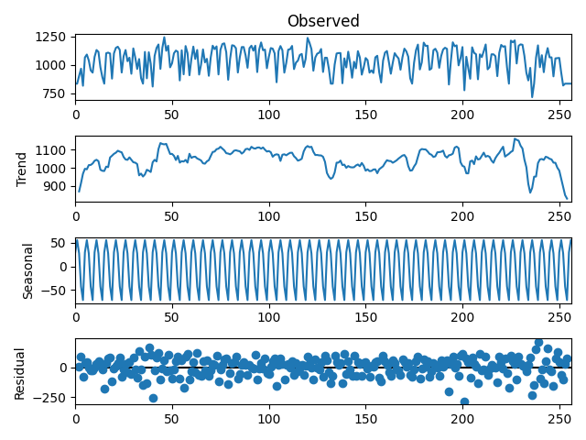
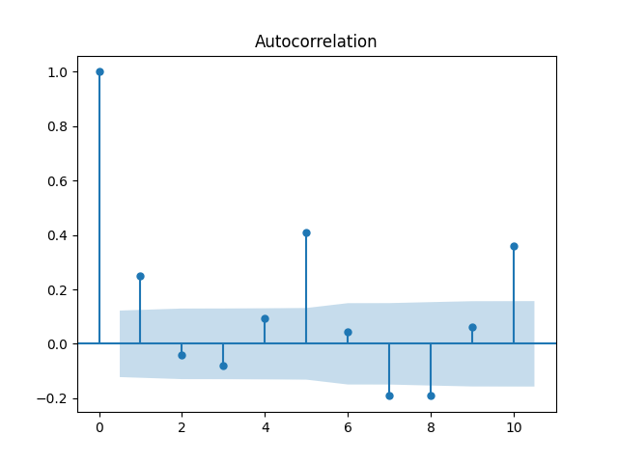
Riders are cyclical
Weekday Cycles
Time Series
Auto Correlation
Stationary
Peaks at 5, 10…
Figure 8.
Riders by month autocorrelation generated by Python Statsmodel
Notes:
When looking at riders over time as a series, there is clearly a cyclical pattern.
First, the data must be stationary to look at periodicity. An Augmented Dickey-Fuller test shows the data is stationary or not changing significantly over the year.
It is clear from the earlier plot that the hours are peaked at 7 to 8, but now it is apparent that the days are periodic and have about a 100 rider peak to peak dynamic change.
To determine if these are significant, an autocorrelation plot is used, where there is a strong peak at 5, which is the exact number of days per week in this case (weekends filtered out).
This indicates that riders are cyclical each week over the year.

Slide 10
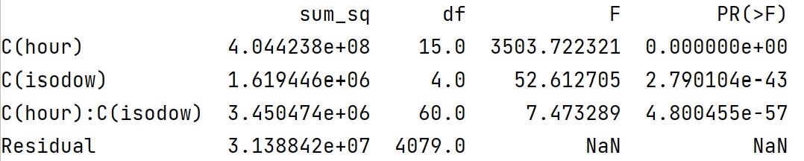
Hypothesis test results
RQ1 – Riders are related to day of week and hour of day
2-Way ANOVA
P-Value
Hour
Day of Week
Hour and Day
But where is the effect?
Figure 7
ANOVA results generated by Python Statsmodel
Notes:
To validate that riders are dependent on the hour and day of week, a 2-way ANOVA is used to test for interactions between hours and days of the week.
The p-value is well below 0 for all factors, including the combined factor of hour and day of week, where the NULL hypothesis can be rejected that there is no differences in riders between day of the week and hour.
However, while the ANOVA test does tell us we have significant factors, it does not tell us about the factors and how they are affecting ridership.
Look at the riders differently, over time as a “time series.”

Slide 11
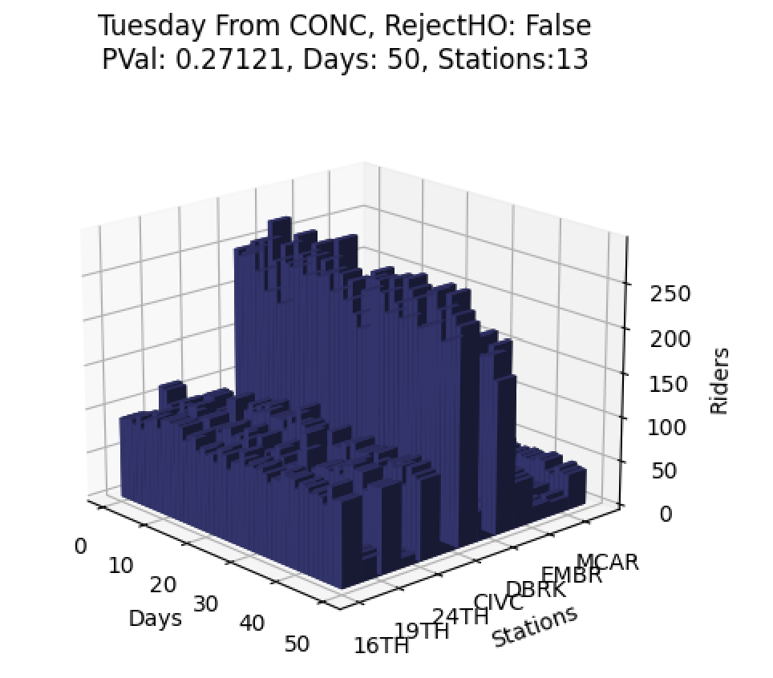
Departing riders
RQ2 Do the same distribution of riders go to same stations each morning
Same Proportions
Consistent or Random
Chi-Square test for homogeneity
P-value 0.27
Figure 9. Riders departing each day for 2019 generated by Python Matplotlib
Notes:
This next hypothesis, that departing riders travel to the same stations each morning is critical to the overall assumption that rider travel in predictable patterns. This hypothesis looks at where riders travel to each morning.
To test the hypothesis, the Concord station is looked at for Tuesday commutes (Tuesday being a heavy commuter day established above) and the set of (source-destination) routes are tabulated with total riders for day departing at 7:00AM. To test the hypothesis, the chi-square test for homogeneity is used to determine if riders follow the same routes and in the same proportions each morning. For example, do 20% of riders head to Embarcadero and 30% to the Civic Center and so on each morning, regardless of the total number of riders. Are the routes and proportion of riders the same each day?
Looking at the two plots, which show the same information only in different formats, the daily distribution of riders departing Concord station is plotted over a year. If riders travel the same routes, the overlays should mostly line up plus or minus random data. Both plots confirm this as there is very little variation in distributions each day.
Each plot shows the route distribution normalized to a full scale of 0-100 to make comparisons between days relative to proportions of travelers
Of the 50 days of routes compared. A test was conducted to determine whether the routes had the same proportion of routes. The chi-square test indicated that the routes were similarly distributed (χ²(2) = 608, p = .27) where we can not reject the NULL or accept the alternate hypothesis

Slide 12
BART over the years
RQ4 – Are BART Riders decreasing
COVID-19
Filter out
Declining, slowly
P-Value < 0.001
Figure 11. Riders over time by month
Generated by Python Matplotlib
Notes:
Lastly, look at BART ridership over the year. Is BART losing riders?
Plot the total riders each month over the last nine years and there appears a slight upward, then downward trend, but very hard to see.
COVID-19 causes a sharp decline of riders in 2020, as expected.
To view if riders are falling off, remove COVID-19 years and focus on just the portion that appears in the decline, from 2016 to 2019.
There is a slight downward trend, although significant variance is observed on the plot.
The P-Value for the slope is 0.001, indicating the NULL hypothesis that no slope is present, is rejected in favor or the alternate at 0.05 alpha level, that is there is a slight downward trend of riders since 2016.

Slide 13
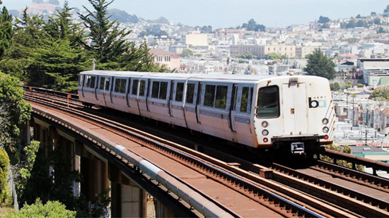
Conclusion
Riders are predictable by day of week and hour of day
Riders follow the same commuter patterns each day to their destinations
Opportunity for Direct Marketing
Local Businesses
BART Services
Declining and why?
Happy Riders
Environmental Benefits
Figure 12. From News from Neighboring States for Feb. 27, 2018: Real estate developments in 3 states, 2018, Rose Law Group Reporter (https://News from Neighboring States for Feb. 27, 2018: Real estate developments in 3 states - Rose Law Group Reporter).
Notes:
While many subway and public transportation studies focus on the number of riders entering and exiting stations, few look at the ridership route distributions patterns. The distribution patterns tell us where the proportion of riders are heading each morning. Armed with this information, local businesses, riders and BART itself can offer improved services and increase the quality of riders’ commute each day.
The results show that riders are dependent on the time of day and day of week and riders commute in repeatable routes to their destinations. Riders departing and arriving at select stations, come from the same population of commuters. The results show that both departing and arriving trains have consistent proportions of riders from fixed stations.
This is a remarkable result. Local business can advertise or promote goods and services to a very specific and predictable set of riders. BART can use this to enhanced rider services (Keler et al., 2020).
Another benefit is happy riders. The better riders are served and the happier they are, the more likely they will continue to use and enjoy BART and help the environment (Ćetković et al., 2020).

Slide 14

Recommendations
COVID-19 Impacts
Do Riders still follow the same routes?
Has working from home changed
Are riders more worried about trains and Covid-19
What and how can BART help local businesses, BART and Riders today
Figure 13. From How Remote Working Is Reshaping A Future New World Of Work, by Bryan Robinson, Ph.D., 2020, Forbes (https://www.forbes.com/sites/bryanrobinson/2020/05/04/how-remote-working-is-reshaping-a-future-new-world-of-work/?sh=1838e95627bf).
Notes:
One limitation of this study, is Covid-19 effects (Tan & Ma, 2020) . The purpose of this study is to look at the pattens riders take each day, and if those patterns are repeatable. It is likely data would need to be separated between pre and post Covid-19 periods. As BART schedules were changed and train availability was drastically reduced during Covid19, it is very possible that route patterns remained unchanged. This would only strengthen this research if accurate. Currently, this is not a hypothesis test in this study.
If riders are shown in this study to commute is consistent routes each day, it would be very interesting to see how those patterns are similar or changed during Covid-19 periods. Did riders still use the same commutes, just drastically reduced in numbers? How were riders affected? How has working from home affected BART riders? Are riders more apprehensive of public transportation with the recent pandemic?
With local businesses struggling to get back up and running, can this study or study like this help?

Slide 15
References
Andrews, M., Luo, X., Fang, Z., & Ghose, A. (2016). Mobile ad effectiveness: Hyper-contextual targeting with crowdedness. Marketing Science, 35(2), 218–233.
Ćetković, J., Lakić, S., Bogdanović, P., Vujadinović, R., & Žarković, M. (2020). Assessing environmental benefits from investment in railway infrastructure. Polish Journal of Environmental Studies. https://doi.org/10.15244/pjoes/109849
Ercan, T., Onat, N. C., & Tatari, O. (2016). Investigating carbon footprint reduction potential of public transportation in United States: A system dynamics approach. Journal of Cleaner Production, 133, 1260–1276.
Lucan, S. C., Maroko, A. R., Sanon, O. C., & Schechter, C. B. (2017). Unhealthful food-and-beverage advertising in subway stations: Targeted marketing, vulnerable groups, dietary intake, and poor health. Journal of Urban Health: Bulletin of the New York Academy of Medicine, 94(2), 220–232.
Ketelaar, P. E., Bernritter, S. F., van Woudenberg, T. J., Rozendaal, E., Konig, R. P., Hühn, A. E., Van Gisbergen, M. S., & Janssen, L. (2018). “Opening” location-based mobile ads: How openness and location congruency of location-based ads weaken negative effects of intrusiveness on brand choice. Journal of Business Research, 91, 277–285.
Kou, W., Chen, X., Yu, L., Qi, Y., & Wang, Y. (2017). Urban commuters’ valuation of travel time reliability based on stated preference survey: A case study of Beijing. Transportation Research. Part A, Policy and Practice, 95, 372–380.

Slide 16
References
Sustainability. (n.d.). Bart.Gov. Retrieved April 18, 2021, from https://www.bart.gov/about/projects/cars/sustainability
Tan, L., & Ma, C. (2020). Choice behavior of commuters’ rail transit mode during the COVID-19 pandemic based on logistic model. Journal of Traffic and Transportation Engineering (English Edition). https://doi.org/10.1016/j.jtte.2020.07.002
Vukasović, T. (2020). Understanding the consumers’ personal characteristics as the starting point for targeted marketing. Management, 15(1), 29–41.
Wang, X., Rodríguez, D. A., Sarmiento, O. L., & Guaje, O. (2019). Commute patterns and depression: Evidence from eleven Latin American cities. Journal of Transport & Health, 14(100607), 100607.
Xu, B., & Hao, J. (2017). Air quality inside subway metro indoor environment worldwide: A review. Environment International, 107, 33–46.

